Slide 1
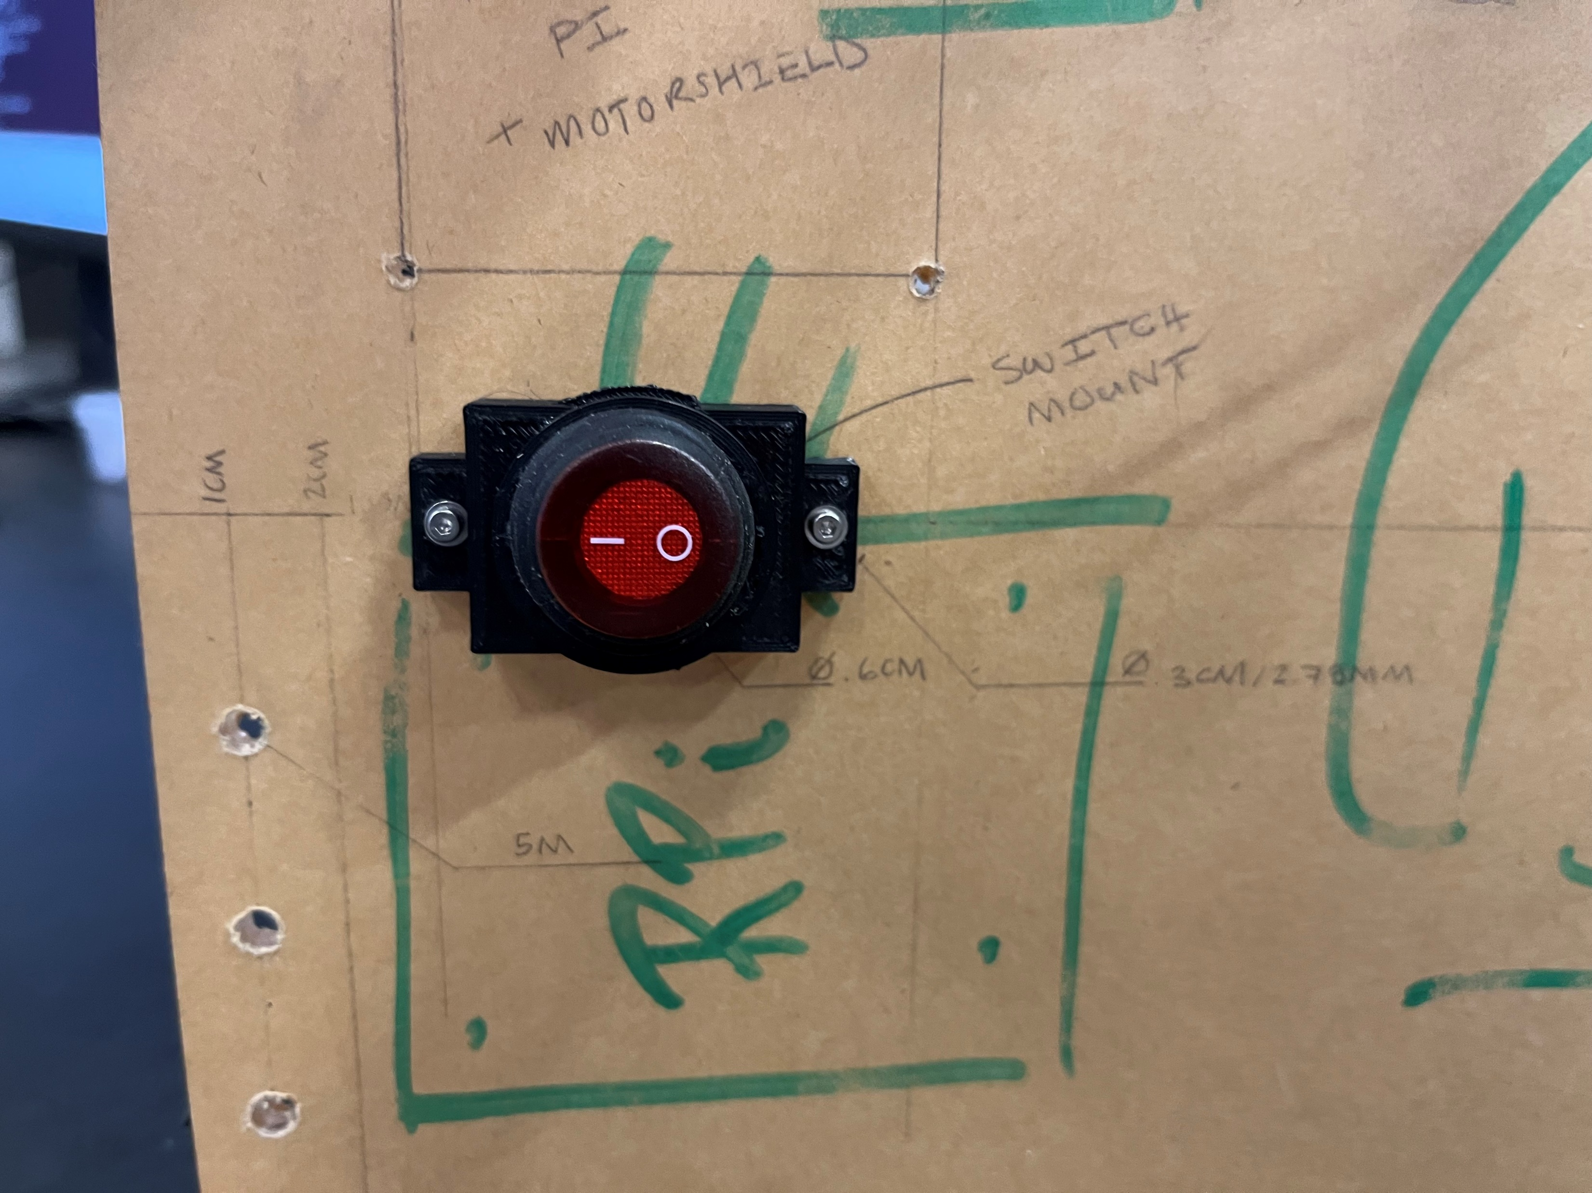
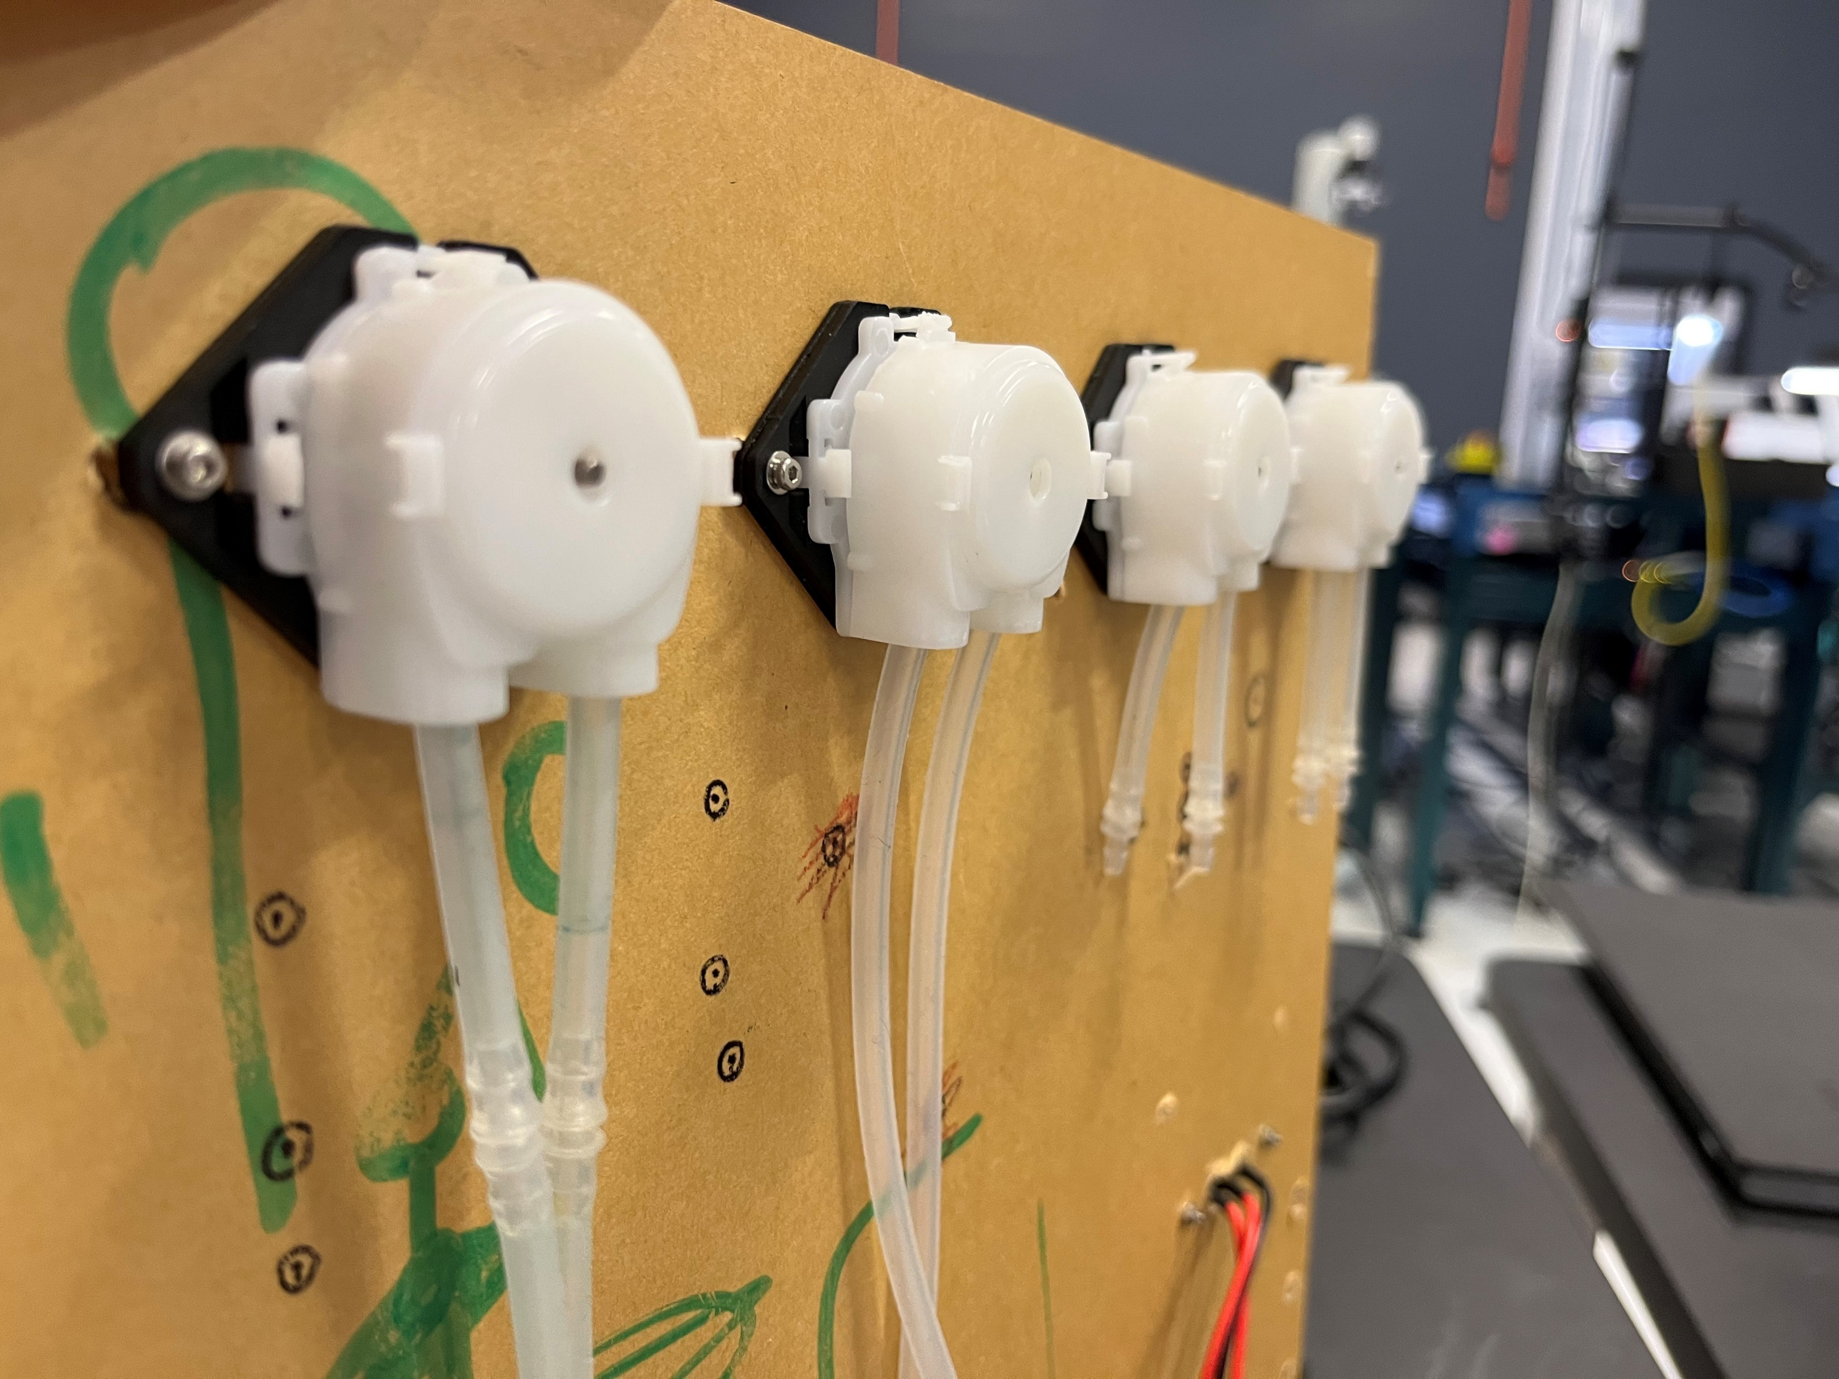
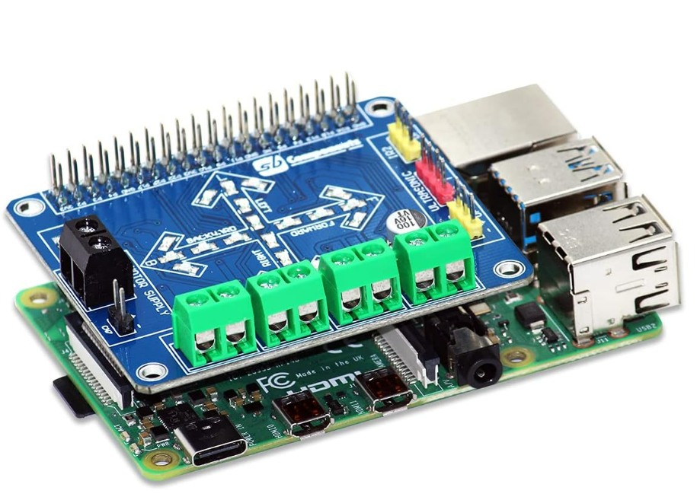
Aileen Cleary – 07/27/2023
Overall Goal: 1) Create an autonomous liquid refill system for Color Picker
Weekly Goal: Build Barty and begin working on code.
Progress:
Updated 3D model with new parts and marked new holes for drilling.
Drilled holes to mount switch, raspberry pi, and motors.
Printed switch mount.
Mounted motors and switch/switch holder onto board.
Rewrote code to control Barty to be compatible with new controller.
Began integrating Barty into main color picker application and tested code by running color picker.
Next Steps:
Continue integrating Barty into color picker experiment.
Work on adding a fourth color to color picker.
Hopefully receive parts to finish building Barty.
Continue running color picker and testing Barty.
Challenges:
3D printer malfunctions.
Mismeasured locations for drilling.
Delay in receiving necessary parts to build.
Changes in design.
Color picker not working again.
Journal club responsibilities.

